Slide 1
HTML
HTML is a markup language used to control how web pages appear in a browser.
HTML consists of key components called tags. Examples:
<h1> </h1>
<html> </html>
<body> </body>
<p> </p>
Tags are often used in pairs.

Slide 2
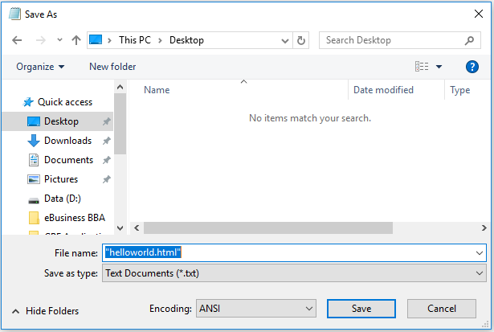
A Simple “Hello World” Page
You can write web pages using any text editor. Today, we will use Notepad.
Copy and paste the following text into Notepad. Save it as “helloworld.html”
<!DOCTYPE html>
<html>
<head>
<title>This is a title</title>
</head>
<body>
<p>Hello world!</p>
</body>
</html>
Don’t forget to use double quotation marks to enclose the file name.

Slide 3
Explanation
The <!DOCTYPE html> declaration defines this document to be HTML5
The <html> element is the root element of an HTML page
The <head> element contains meta information about the document
The <body> element contains the visible page content
The <p> element defines a paragraph
Question:
What do <title> and </title> do?

Slide 4
Exercise
Now, add a heading before the paragraph using the <h1> and </h1> tags.
What happens if you change <h1> to <h3> and </h1> to </h3>?
<!DOCTYPE html>
<html>
<head>
<title>This is a title</title>
</head>
<body>
<h1>Heading 1</h1>
<p>Hello world!</p>
</body>
</html>

Slide 5
Formatting
There are a number of tags for formatting, including:
<b> and </b> : enclosed text is in boldface
<i> and </i> : enclosed text is italicized
For other, please refer to https://www.w3schools.com/html/html_formatting.asp
Try making the word “Hello” bold and “world” italic.
<!DOCTYPE html>
<html>
<head>
<title>This is a title</title>
</head>
<body>
<h1>Heading 1</h1>
<p><b>Hello</b> <i>world</i>!</p>
</body>
</html>

Slide 6
Lists
There are two types of lists: Unordered <ul> and Ordered <ol>.
Compare the difference between the following:
<!DOCTYPE html>
<html>
<head>
<title>This is a title</title>
</head>
<body>
<h1>Heading 1</h1>
<p>Hello world!</p>
<p>Unordered List:</p>
<ul>
<li>item 1</li>
<li>item 2</li>
<li>item 3</li>
</ul>
</body>
</html>
<!DOCTYPE html>
<html>
<head>
<title>This is a title</title>
</head>
<body>
<h1>Heading 1</h1>
<p>Hello world!</p>
<p>Ordered List:</p>
<ol>
<li>item 1</li>
<li>item 2</li>
<li>item 2</li>
</ol>
</body>
</html>

Slide 7
Hyperlinks
Now, add the following paragraph after the “Hello world paragraph:
<p> Go to Google. </p>
We would like to take the user to the Google website when the word “Google” is clicked.
This is done by the <a> and </a> tags. You will need to provide the web address within the <a> tag by defining the “href” attribute, e.g.,
<a href="url">link text</a>

Slide 8
Hyperlinks (Cont’d)
<!DOCTYPE html>
<html>
<head>
<title>This is a title</title>
</head>
<body>
<h1>Heading 1</h1>
<p><b>Hello</b> <i>world!</i></p>
<p> Go to <a href="http://www.google.com">Google</a>. </p>
</body>
</html>
This is called an absolute URL because the complete address is specified.

Slide 9
Hyperlinks (Cont’d)
However, if you want to link to another webpage that is stored in the same folder, you can use a relative URL.
Now, save your helloworld.html in a folder called "Lab1Web"
Create a second webpage. Let's call it "page2.html"
page2.html
<!DOCTYPE html>
<html>
<head>
<title>This is Page 2</title>
</head>
<body>
<h1>Heading 1</h1>
<p>This is Page 2.</p>
</body>
</html>

Slide 10
Hyperlinks (Cont’d)
Now, return to helloworld.html and change the link:
In a browser, test whether the link works.
<!DOCTYPE html>
<html>
<head>
<title>This is a title</title>
</head>
<body>
<h1>Heading 1</h1>
<p><b>Hello</b> <i>world!</i></p>
<p> Go to <a href="page2.html">Page 2</a>. </p>
</body>
</html>

Slide 11
Hyperlinks (Cont’d)
You can specify where to open the linked document using the target attribute.
target="_blank" opens the page in a new window or tab.
target="_self" is the default and opens the linked page in the same window.
<!DOCTYPE html>
<html>
<head>
<title>This is a title</title>
</head>
<body>
<h1>Heading 1</h1>
<p><b>Hello</b> <i>world!</i></p>
<p> Go to <a href="page2.html" target="_blank">Page 2</a>. </p>
</body>
</html>

Slide 12
Images
Download an image / picture from the Internet and save it in the Lab1Web folder.
We now add the picture at the end of helloworld.html
I have named my image "myimage.jpg". To insert this image onto the page, I need to use the <img> tag:
<img src="myimage.jpg">
See the next page for the complete html code.

Slide 13
Images (Cont'd)
<!DOCTYPE html>
<html>
<head>
<title>This is a title</title>
</head>
<body>
<h1>Heading 1</h1>
<p><b>Hello</b> <i>world!</i></p>
<p> Go to <a href="page2.html">Page 2</a>. </p>
<img src="myimage.jpg">
</body>
</html>

Slide 14
CSS
CSS stands for Cascading Style Sheets.
CSS is a language that defines the styles of different elements in an HTML document.
You can define CSS styles within an HTML document. These styles will only affect the current document.
Let's add styles to <body>, <h1> and <p> to our helloworld.html.
We define the styles inside the tags <head> and </head>. See the next slide.

Slide 15
CSS (Cont'd)
<!DOCTYPE html>
<html>
<head>
<title> This is a title </title>
<style>
body {
background-color: lightblue;
}
h1 {
color: white;
text-align: center;
}
p {
font-family: verdana;
font-size: 20px;
}
</style>
</head>
<body>
<h1>Heading 1</h1>
<p>Hello world!</p>
</body>
</html>
What is the advantage of CSS? Can't we format each element in the HTML document one by one?

Slide 16
CSS (Cont'd)
CSS selectors are used to "find" (or select) HTML elements based on their element name, id, class, etc.
The element selector selects elements based on the element name. For example:
with the above, all <p> elements will be selected and formatted with the defined styles.
p {
font-family: verdana;
font-size: 20px;
}

Slide 17
External Style Sheet
What if I want to apply the same styles on page2.html? Do I need to copy and past everything from <style> to </style> and paste in the <head> section of page2.html?
What if I have many pages? Should I copy and paste the same styles on to these pages one by one?
What is the problem of this approach?
You can save the styles in a file. In each html document that applies these styles, refer to this file.

Slide 18
External Style Sheet
Copy the contents enclosed by <style> and </style> into a different text file. Name the text file "lab1css.css":
lab1css.css
body {
background-color: lightblue;
}
h1 {
color: white;
text-align: center;
}
p {
font-family: verdana;
font-size: 20px;
}
When you save this file in Notepad, please use "Save As…" and specifiy "lab1css.css" (with double quotation marks) as the file name. Otherwise, the file may be saved as lab1css.css.txt.

Slide 19
External Style Sheet (Cont'd)
Now, in both helloworld.html and page2.html, refer to this file in the <head> section of the html document using the <link> tag.
helloworld.html
<!DOCTYPE html>
<html>
<head>
<title>This is a title</title>
<link rel="stylesheet" type="text/css" href="lab1css.css">
</head>
<body>
<h1>Heading 1</h1>
<p>Hello world!</p>
</body>
</html>

Slide 20
External Style Sheet (Cont'd)
page2.html
<!DOCTYPE html>
<html>
<head>
<title>This is Page 2</title>
<link rel="stylesheet" type="text/css" href="lab1css.css">
</head>
<body>
<h1>Heading 1</h1>
<p>This is Page 2.</p>
</body>
</html>

Slide 21
Inline Styles
If a specific element is very special, you can overwrite the internal or external style sheets using inline styles.
For example, perhaps the paragraph "Hello world!" is very special and you want to give it a different color than other paragraphs in the website.
You can rewrite that paragraph to:
<p style="color:red;">Hello world!</p>
See the next slide.

Slide 22
Inline Styles (Cont'd)
helloworld.html
<!DOCTYPE html>
<html>
<head>
<title>This is a title</title>
<link rel="stylesheet" type="text/css" href="lab1css.css">
</head>
<body>
<h1>Heading 1</h1>
<p style="color:red;">Hello world!</p>
</body>
</html>

Slide 23
Divisions in a Web Page
Starting from this slide, the concepts presented become quite complex.
There is no need to go through the following slides if you find the contents too difficult.
A typical web page design divides the page into different sections.
Header
Navigation Bar
Main Content Page
Footer

Slide 24
<div>
For each of the sections, you can create a <div> element and assign a class to it so that you can refer to the specific <div> element easily.
For example, we can name the class for the header header, the navigation bar sidebar, the footer footer and the main content content.
We will also need to define a container to hold these <div> elements together. The container will also be a <div> element. We will call this class container.
It is like a big box containing smaller boxes.
Then, we can define the properties of these classes…

Slide 25
<div> (Cont'd)
In lab1css.css, we will add the following codes to define the property of these classes.
.header {
float: left;
width: 100%;
background-color: pink;
}
.content {
width: 85%;
float: left;
background-color: green;
}
.sidebar {
float: left;
width: 15%;
background-color: blue;
}
.footer {
background-color: yellow;
clear:both;
}
.container {
width: 960px;
background-color: purple;
}

Slide 26
<div> (Cont'd)
Within the <body> element…
<div class="container">
<div class="header">
<h1> header </h1>
</div>
<div class="sidebar">
<h2> sidebar </h2>
</div>
<div class="content">
<p> content </p>
</div>
<div class="footer">
<p> footer </p>
</div>
</div>

Slide 27
In other words, create page3.html with contents below:
<!DOCTYPE html>
<html>
<head>
<title>This is Page 3</title>
<link rel="stylesheet" type="text/css" href="lab1css.css">
</head>
<body>
<div class="container">
<div class="header">
<h1> Header</h1>
</div>
<div class="sidebar">
<h2>Sidebar </h2>
</div>
<div class="content">
<p> contents </p>
</div>
<div class="footer">
<p> <i>footer</i> </p>
</div>
</div>
</body>
</html>

Slide 28
Exercise
Play with the different parameters in lab1css.css
Change the .container width to 100% (instead of 960px)
Change the .content width to 75%
Change the .content float to right
Remove "clear:both;" from .footer

Slide 29
<Div> (Cont'd)
I would like the footer to stay at the bottom of the page…
Solution 1: Ensure there is enough contents in .content and .sidebar
Solution 2: Change the .footer declaration in lab1css.css to:
.footer {
background-color: yellow;
clear:both;
position: absolute;
bottom: 0;
left: 0;
right: 0;
}

Slide 30
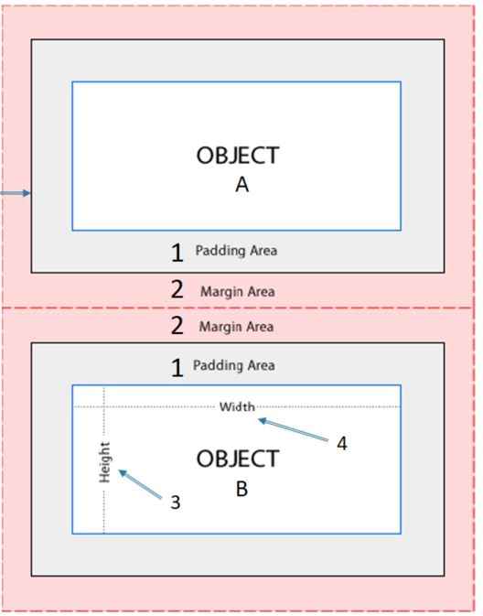
CSS Box Model
CSS box consists of 4 elements surrounding the given object:
Padding
Margin
Width
Height
We can set the sizes of the elements in term of the number of pixels or other measurement units.
Border

